Slide 1
Accelerate
Shaun Walker
Co-Founder & CTO
DotNetNuke Corporation

Slide 2
AGENDA
Overview
Progress
Business
Vision

Slide 3
OVERVIEW
What is DotNetNuke?

Slide 4
CMS
DotNetNuke® is the Leading
Web Content Management Platform
for Microsoft .NET

Slide 5
OPEN SOURCE
DotNetNuke® is the Largest and
Most Successful Open Source Project
native to the Microsoft Platform

Slide 6
PLATFORM
DotNetNuke® is the only Web CMS for .NET
which offers more than 8000 Apps
in its Commercial Marketplace

Slide 7
AGENDA
Overview
Progress
Business
Vision

Slide 8
DOWNLOADS
2010
700,000
All-Time
Over 6 Million
Source: Codeplex.com

Slide 9
DOWNLOADS
Over 6 million downloads all-time; more than 200,000 downloads per quarter
Cumulative Downloads by Year
Source: Codeplex.com

Slide 10
USERS
Over 800,000 registered users; more than 20,000 new registrations per quarter
Cumulative Registrations by Year
Source: DotNetNuke.com

Slide 11
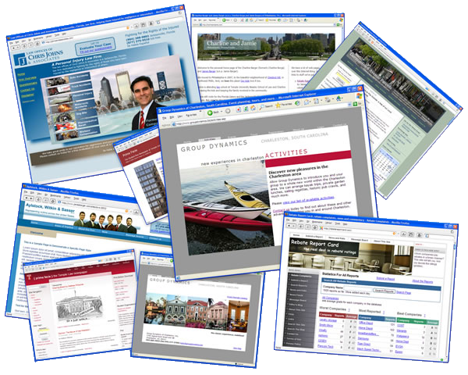
WEBSITES
Websites Powered By DotNetNuke
Over
600,000
*Estimate

Slide 12
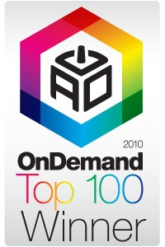
RECOGNITION
Open Source 50

Slide 13
CONFERENCES
OpenForce Europe Zeist, The Netherlands, October 2010
DotNetNuke Connections Las Vegas, Nevada, November 2010

Slide 14
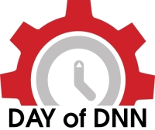
USER EVENTS
DayofDNN Paris – May 2010 DayofDNN Chicago - October 2010
Hackathon Orlando (MVP) Hackathon Washington, DC (UI/UX) Hackathon St. Louis (Mobile)
Hackathon Redmond (Razor)

Slide 15
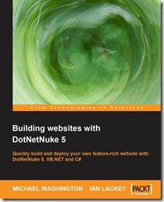
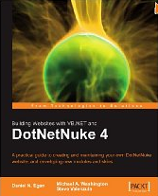
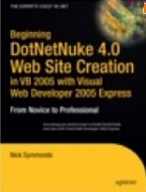
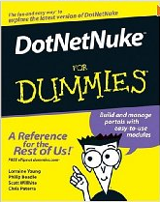
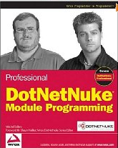
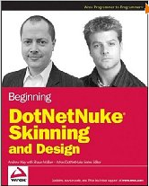
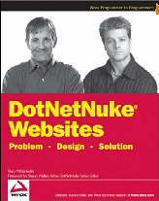
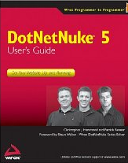
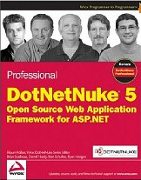
PUBLICATIONS

Slide 16
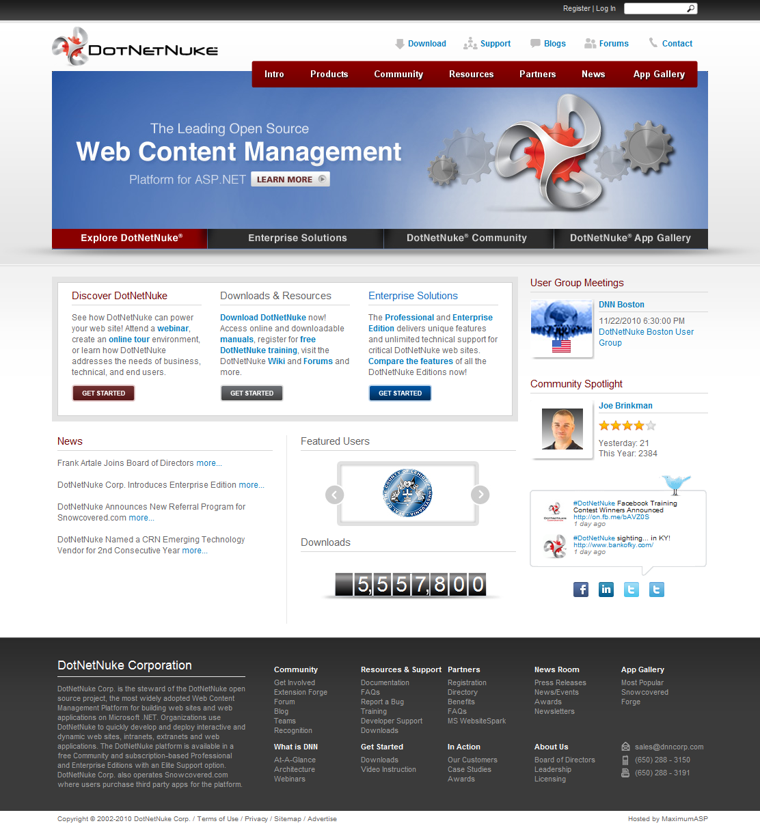
DOTNETNUKE.COM
Launched last week…
A complete overhaul of our flagship website providing a new modern professional
appearance and enhanced information architecture

Slide 17
RELEASES
User Messaging Ribbon Control Panel Content Staging Folksonomy User Profile Content Localization RichTextEditor Output Caching Provider Document Management Taxonomy
5.2
5.3
5.4
5.5
4 Major Releases; 8 Minor Releases

Slide 18
NEXT RELEASE
DotNetNuke 5.6
Auto Portal Alias Mapping
Configuration Manager
Multiple File Uploads in File Manager
Default.css Optimization for Designers
SQL Server Performance Improvements
Google Analytics Upgrade
Advanced Search Engine Integration
Html Module Content Locking
Hierarchical Workflow Delegation
Google Analytics Segmentation
+ 56 Bug Fixes
Available November 17!

Slide 19
AGENDA
Overview
Progress
Business
Vision

Slide 20
VISION
To be the
most deployed and most valuable
web content management platform
in the world!

Slide 21
MISSION
To create an open source web content management platform that cultivates a passionate community and a prosperous commercial ecosystem

Slide 22
FUNDING
In January 2010 DotNetNuke Corporation announced that it had raised a pre-emptive $8M Series B round of funding led by Pelion Venture Partners, and joined by current Series A investors August Capital and Sierra Ventures

Slide 23
BOARD OF DIRECTORS
Navin Nagiah President & CEO
12+ years General Management; 7+ years CEO experience
3+ years as CEO of an open source company (CIGNEX)
Shaun Walker Co-Founder & CTO
Original Creator of DotNetNuke
Responsible for Product Management and Technical Leadership
Larry Augustin
Open Source Strategist and Visionary
Sits on the board of 8 Venture Backed Open Source Companies
Founder and CEO of VA Linux which had an IPO in 1999
Vivek Mehra August Capital
Founder of Cobalt (Acquired by SUN for $2B+)
Current Investments include DotNetNuke, PulseCore Semiconductors, and Virsto Software.
Tim Guleri Sierra Ventures
Founder and CEO of Octane Software (Sold to Epiphany for $3.2B+)
Investor and Board Member at Open Source Company SourceFire (NASDAQ: FIRE)
Chris Cooper Pelion Venture Partners
Former Director of Partner Engineering and Developer Services, and General Manager of Strategic Alliances at Novell, Inc.
Frank Artale
VP of Business Development at Citrix Systems
Founder and CEO of Consera Software, acquired by HP in 2004
9 years experience at Microsoft Corporation, GM in Windows 2000 Group

Slide 24
BUSINESS GROWTH
Engineering Headquarters Vancouver, British Columbia, Canada, 21 employees
Satellite Center,
United Kingdom & Ireland, 2 employees
Business Headquarters San Mateo, California, United States, 21 employees
Satellite Center,
Australia, 1 employee
18 Full-Time Resources Nov/2009; 45 Full-Time Resources Nov/2010

Slide 25
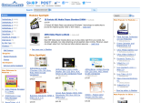
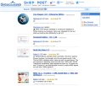
BUSINESS MODEL
Commercial Service Providers
Hosters, SIs, Web Design Firms, VARs, OEM Partners
DotNetNuke Product
DotNetNuke Users
Platform
Commercial Editions
Product Subscriptions Recurring Revenue Model
DotNetNuke Corp. Customers
DotNetNuke Marketplace (Modules and Skins)
50,000 Transactions to 15,000 unique customers yearly eCommerce Sales
Module Vendors
Skin Vendors

Slide 26
PRODUCTS
Product | Community Edition | Professional Edition | Enterprise Edition
Target Customer | Non-specific | Small to Medium Sized Business | Medium to Large Sized Enterprise
Subscription Price | FREE | $2499/year | $4999/year
Standard Support | Community Forums | Unlimited Web Tickets 9-5 PST | Unlimited Web Tickets 9-5 PST
Elite Support | N/A | + Telephone Support ( $2999/yr ) 6-6 PST, Source Code | + Telephone Support ( $2999/yr ) 6-6 PST, Source Code
Network Services | None | Security Center, Health Monitoring, App Integrity | Security Center, Health Monitoring, App Integrity
Feature Differentiation | N/A | Web Farm Support, Document Management, Telerik License, Extended Permissions, Page Caching | Professional Features + Content Staging
License | Open Source | Commercial | Commercial

Slide 27
CUSTOMERS
900
In Under 20 Months!
The fastest growing commercial open source CMS company ever!

Slide 28
USERS

Slide 29
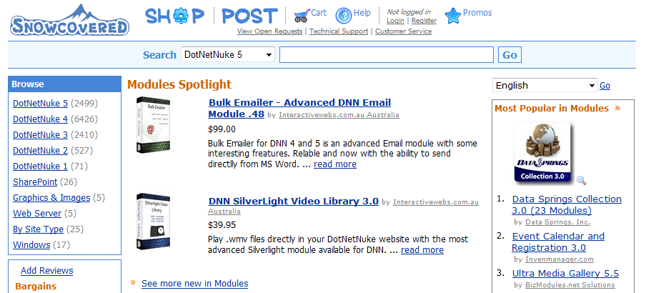
MARKETPLACE
Revitalized Snowcovered Referral Program
50,000 Transactions to 15,000 unique customers

Slide 30
PARTNERS
Over
100
Fusion Partners
In Under 14 Months!

Slide 31
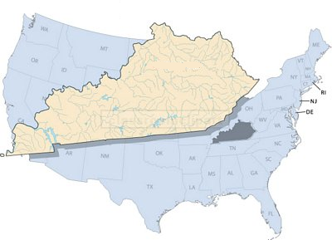
SHOWCASE
State of Kentucky
The Kentucky EASC was formed to define the roles, business models, policies, standards, technologies and decision-making criteria for the acquisition and deployment of Information Technology in the Commonwealth of Kentucky.
Today I am proud to announce….
DotNetNuke is the first Open Source Content Management System
to be approved as a standard
for the State of Kentucky!
Information provided by Gary Buchholz, member of the Kentucky Enterprise Architecture Standards Committee, or EASC.
Notes:
31

Slide 32
SHOWCASE
“The current economy has forced governments and corporations to shift from "More with Less" to "Even More with Even Less", setting the stage for many, including the State of Kentucky, to become more receptive to open source and nontraditional technology solutions. The economy opened the door and the quality of DotNetNuke is what made the final decision.”
Key Points:
DotNetNuke’s popularity has spawned a wealth of third party solutions and resources
DotNetNuke has demonstrated an emphasis on security best practices over its lifetime
TCO is low and ROI is high in comparison to competing solutions
Information provided by Gary Buchholz, member of the Kentucky Enterprise Architecture Standards Committee, or EASC.
Notes:
32

Slide 33
SHOWCASE
Actively engaged with high profile Web Application Ecosystem Partners including DotNetNuke Corporation
Improving value proposition for “breadth” developers
Web Matrix & Razor…
Gavin Warrener
Program Manager Web Platform
Microsoft Corp. Developer & Platform Evangelism

Slide 34
WEB PLATFORM
The is a powerful set of tools, servers, and technologies optimized for building and hosting next generation web applications and solutions.
Tools
Servers
Technologies
Applications
Design and development integration for
pre- packaged applications that run on top of the Microsoft Web Platform.
Programs
Microsoft
BizSpark
Notes:
34

Slide 35
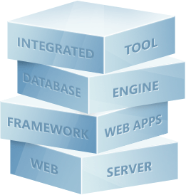
WEB MATRIX
Everything you need to build Web Sites using Windows
<15MB (50 if you include .NET)
IIS Express
SQL Compact Edition
Razor Scripting Language
Development tool
Notes:
35

Slide 36
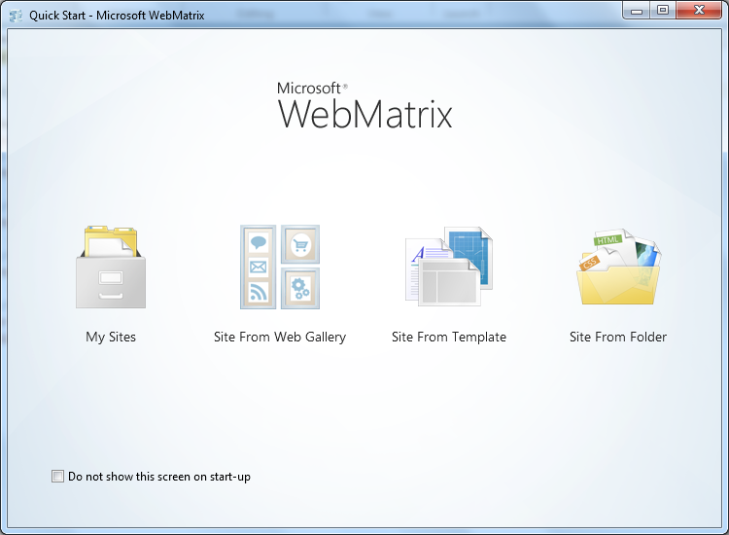
INTEGRATION
+
To see WebMatrix in action… Go to www.microsoft.com/web/webmatrix
Notes:
36

Slide 37
AGENDA
Overview
Progress
Business
Vision

Slide 38
BACKGROUND
In 2007 at OpenForce North America, DotNetNuke Corporation announced ambitious plans for the upcoming Version 5.0 release.
Codenamed “Cambrian” this release planned to tackle major feature areas such as Social Networking, Workflow & Versioning, Content Localization, User Interface, and Core Modules.
Due to lack of funding and resources, progress was slower than anticipated; however, by 2010 many of these features were implemented in the platform in one form or another.
However, the web landscape is rapidly changing….

Slide 39
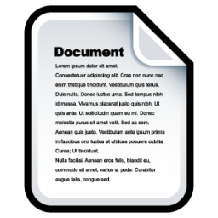
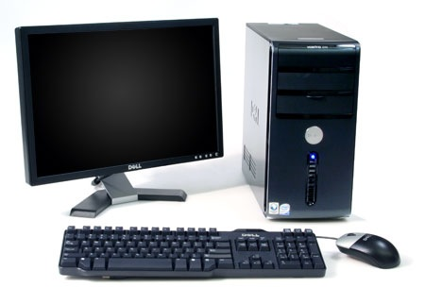
CMS 1.0

Slide 40
CMS 2.0
Mobile Web
Social Web
Open Web
Open Web
Social Web
Mobile Web

Slide 41
INFRASTRUCTURE

Slide 42
INFLECTION POINT
For DotNetNuke to adapt to the changing landscape and remain a leader in the web content management market we must…
A C C E L E R A T E !

Slide 43
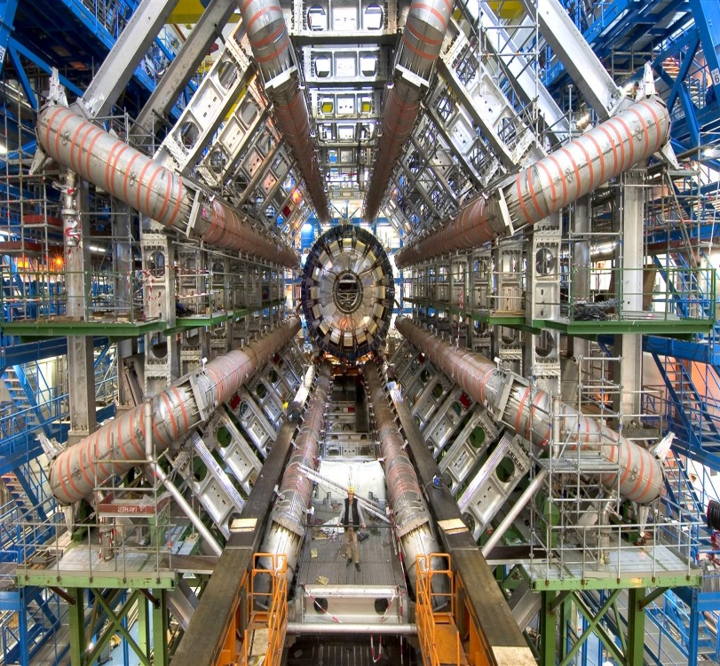
PHYSICS
A hadron is a composite nuclear particle made of quarks held together by a strong force.
The Hadron Collider is the world's largest and highest-energy nuclear particle accelerator. This tool allows opposing particle beams to collide at extremely high energy. Physicists hope it will help answer many of the most fundamental questions of physics, advancing our understanding of the deepest laws of nature.
Hadron is built in collaboration with thousands of individuals from over 100 countries as well as hundreds of universities and laboratories.

Slide 44
CODENAME
We see a variety of parallels between the goals of the Hadron Collider and the next generation version of DotNetuke.
Introducing…
DotNetNuke “Hadron”

Slide 45
HADRON
DotNetNuke 6.0
The Next Generation
Web Content Management Platform
for Microsoft .NET!

Slide 46
HADRON
DotNetNuke 6.0 will be the world’s foremost web platform for easily creating…
modern
easily customizable
social & mobile enabled
feature rich
…websites

Slide 47
ROADMAP
User Experience
“Instant On”
Performance
Social & Mobile
Enterprise Integration

Slide 48
USER EXPERIENCE
Modal “Pop-up” Dialogs
Data Entry “Form” Patterns
Overhauled Admin Modules
Telerik Wrappers
Mega-Menu / New Default Skin
Content Localization Usability

Slide 49
“INSTANT ON”
“On-Demand” version of DotNetNuke
“App Store” integration between DotNetNuke and Snowcovered
Installation and Upgrade Simplification
Business Usage Templates

Slide 50
PERFORMANCE
Database Optimization
Javascript, Style Sheet & ViewState “Minification”
Content Delivery Network Support
CSS Sprites
Website Startup Acceleration
Intelligent Caching

Slide 51
SOCIAL & MOBILE
Seamless Content Publishing to popular Social Channels
Mobile Web Browsing Support for Mobile Devices
Native Mobile App Development Support for Mobile Devices

Slide 52
ENTERPRISE
Integration with Microsoft Office Sharepoint
Document Management
Folder Providers for External Storage
Content Staging

Slide 53
TIMELINE
To satisfy community and customer feedback, we will move to longer release cycles, fewer major releases, and a significant focus on product quality in 2011
DotNetNuke 6.0 Q2 2011
DotNetNuke 6.1 Q4 2011

Slide 54
BUSINESS
Introduce new commercial products and services to provide our customers with greater choice, flexibility and value.
Licensing
Bundles
Express
Edition

Slide 55
PERPETUAL LICENSE
For customers who require a license for perpetual usage of the DotNetNuke product
Will be offered at a premium price as an “Add-On” to the standard Subscription offering
Technical Support and Product Upgrades only available with an Active Subscription

Slide 56
BUNDLES
A complete solution including our commercial products alongwith related services and webinar-based training.
Enables organizations to get up to speed faster, lower operating costs,
and take full advantage of all the available commercial product features.
Available in a number of different configurations to meet your specific business needs.

Slide 57
EXPRESS EDITION
Affordably priced, commercially licensed small business solution
Entry-level product with
limited feature set & limited technical support
Easily upgradeable to Professional or Enterprise

Slide 58
Thank You!
Shaun Walker
Co-Founder & CTO
DotNetNuke Corporation

